Slide 1
Intro to R
A crash course to basic R
Instructor: Sahifa Siddiqua

Slide 2
Software necessary for R
R: A freely available language and environment for statistical computing and graphics, which provides a wide variety of statistical and graphical techniques: linear and nonlinear modelling, statistical tests, time series analysis, classification, clustering, etc. Everything you need to know about R is here.
Rstudio: A free integrated development environment (IDE) designed to support multiple languages, including both R and Python. It’s a user-friendly interface that makes documenting and working with R a lot easier. Everything you need to know about RStudio is here.
STAT 240, Spring 2025, Lecture 1

Slide 3


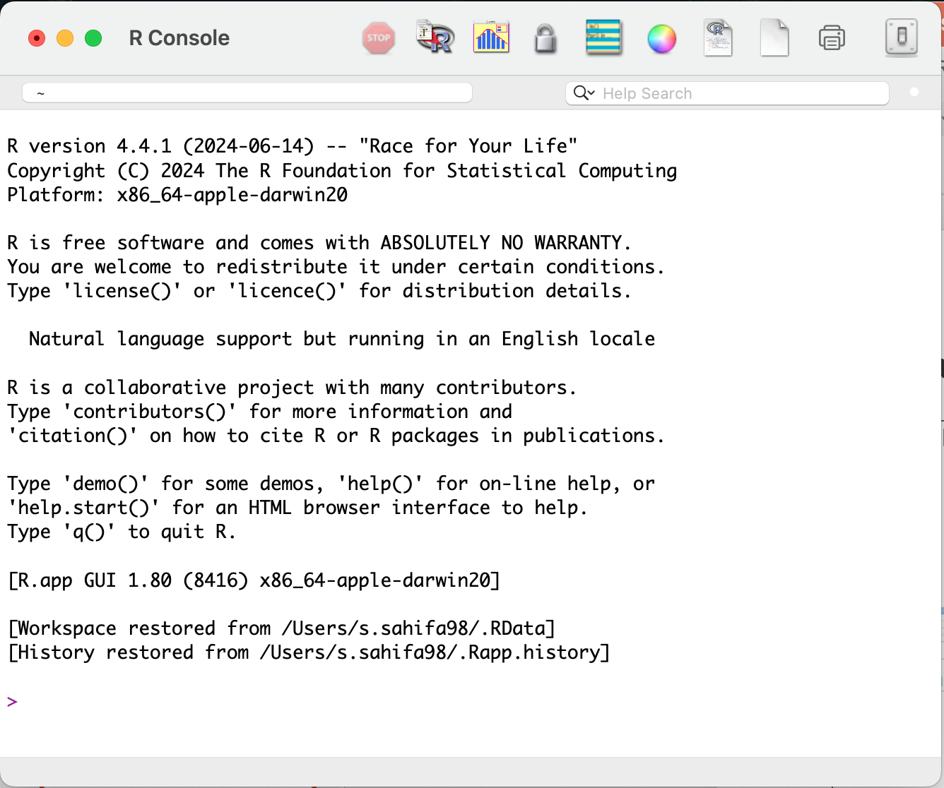
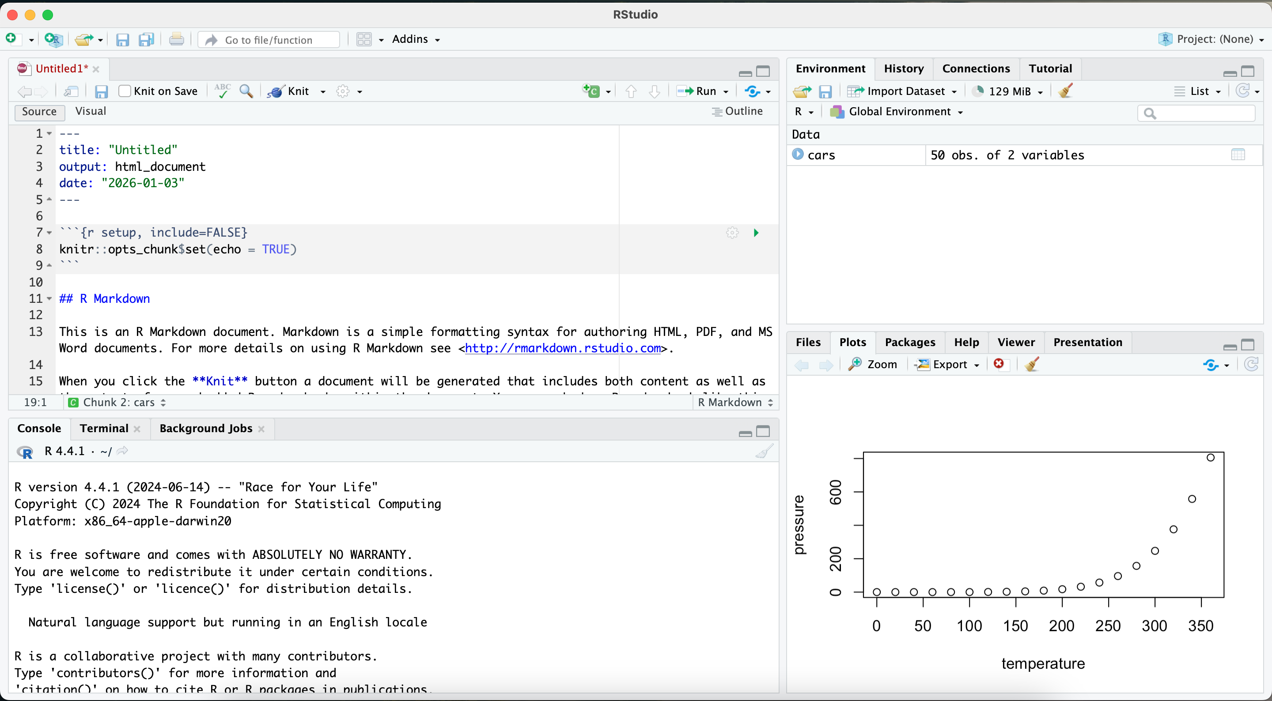
Logo and User Interfaces
R:
RStudio:
Logo
Logo
User Interface
User Interface

Slide 4
Installing R and RStudio
On Your Individual Device

Slide 5
Installing R and RStudio
Leave directories and settings as default unless you know what you’re doing!
https://posit.co/download/rstudio-desktop/
First, click “Download and Install R”. Click “Download R for macOS” or “Download R for Windows” depending on what type of computer you have, in the top box.
MacOS: Click the .pkg file that applies to your computer
Windows: Click “Install R for the first time”, and then “Download R-4.3.2 for Windows”
Then, back at the above link, click “Download Rstudio Desktop”, which will just give you a file.

Slide 6
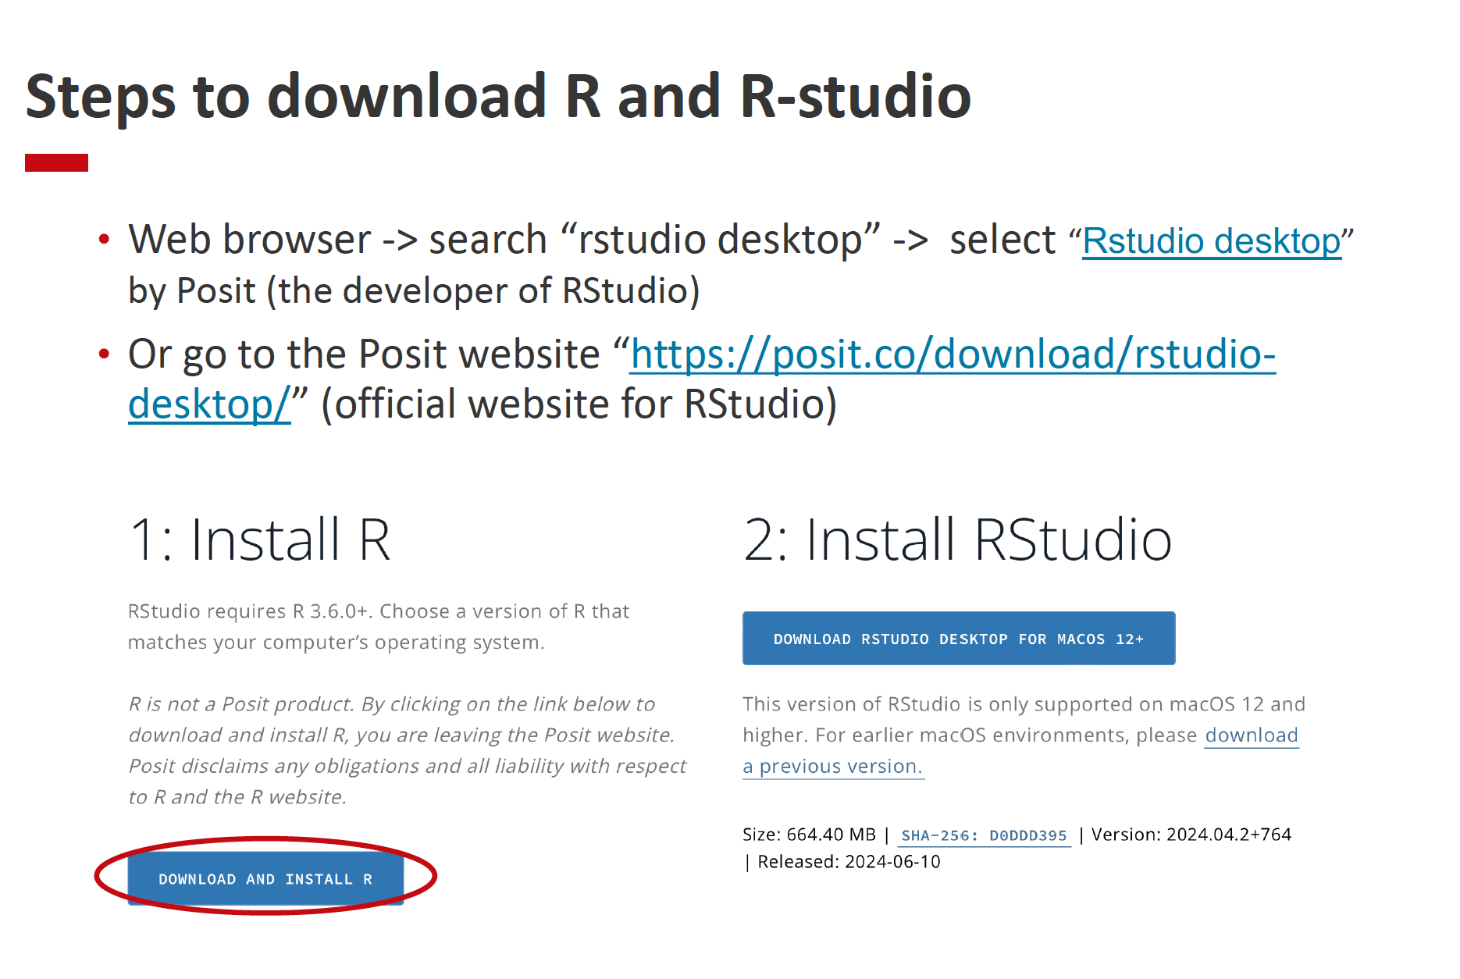

Slide 7
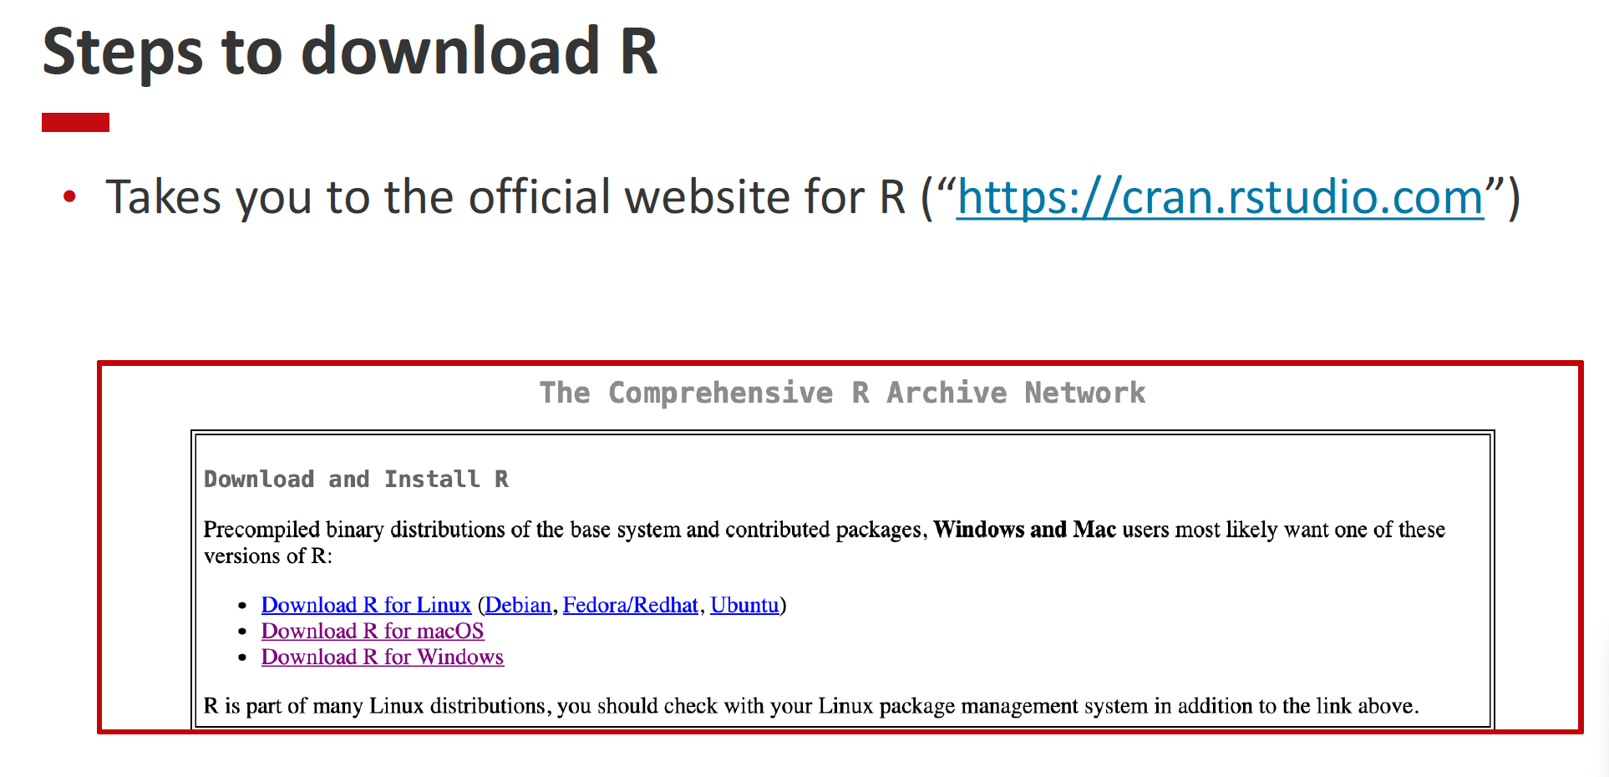

Slide 8
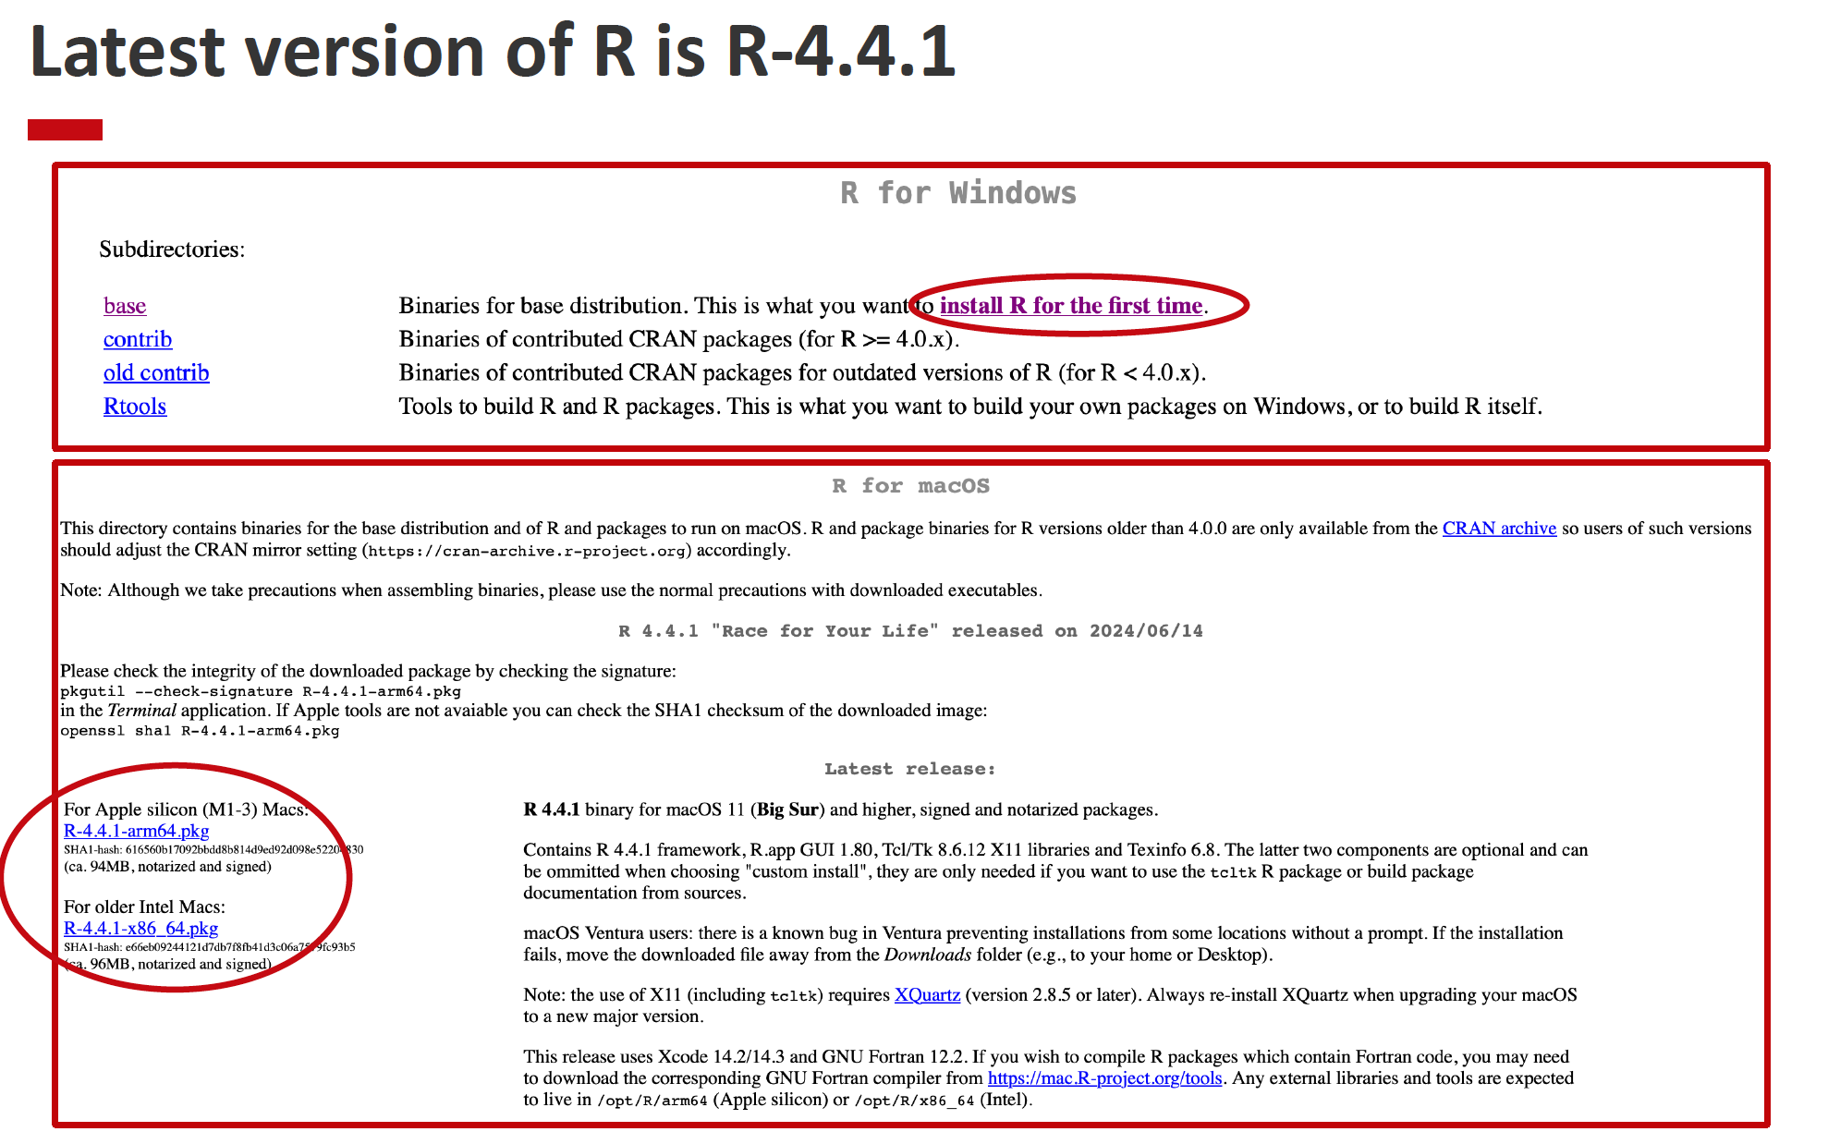

Slide 9
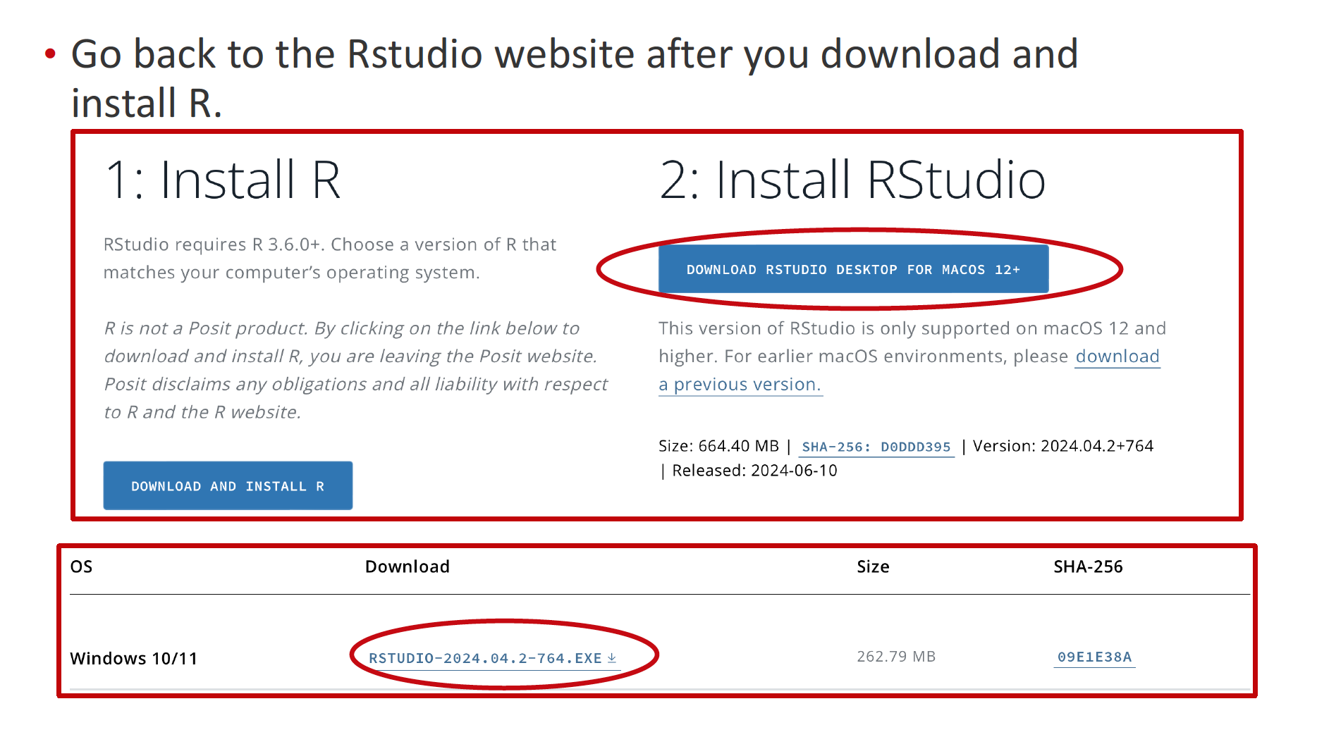

Slide 10
RStudio

Slide 11
User Interface We will use the image below to understand the 4 primary panes/windows of Rstudio. Each Pane will be discussed in details in the following slides
Pane 3
Pane 1
Pane 4
Pane 2

Slide 12
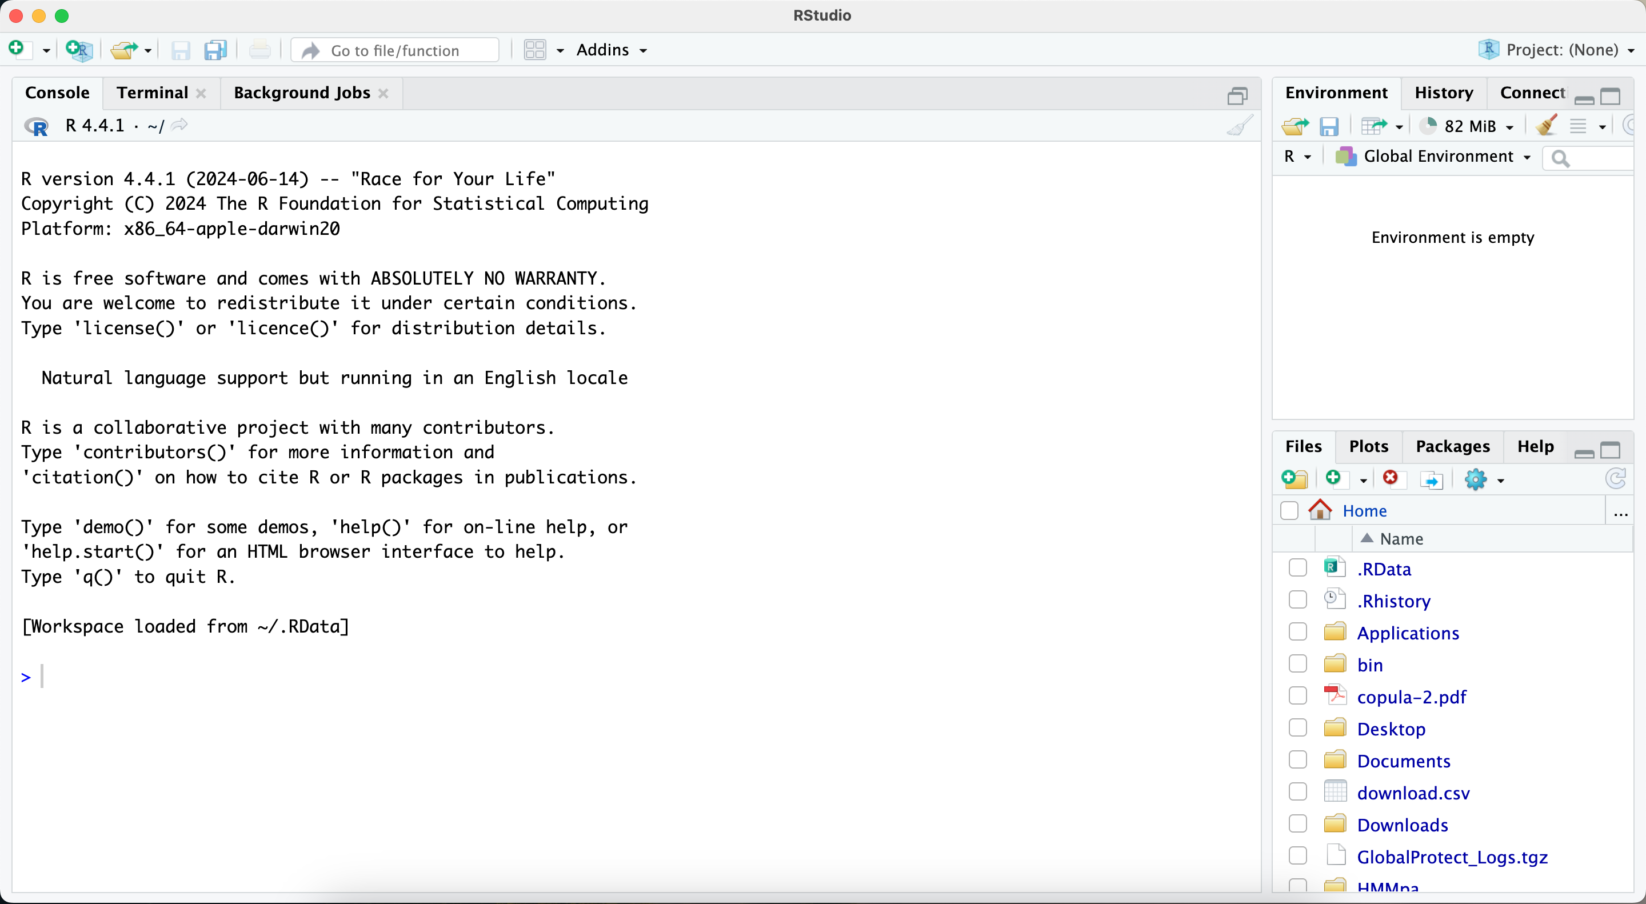
User Interface When you open RStudio for the first time it will only not show Pane 1. This is because Pane 1 is primarily for displaying R format documents. So let’s understand what you will see for the first time. NOTE: All pane names are the same as the image in previous slide and is missing Pane 1.
Pane 3
Pane 4
Pane 2

Slide 13
We will start by understanding other Panes and then at last look at Pane 1.
Pane 2: Console Pane
By default, the console pane is the bottom left pane. The Console tab provides an interactive area for executing code. By default, it is tied to R and looks similar to the R interface. This is the brain of RStudio and uses the R that you installed. Without installing R, you can’t use the console.
You can use the console to write your code directly. But it doesn’t save them in a file for future use. To save your code in a file, use an R format file in the SOURCE tab.
The Console pane also includes an integrated Terminal tab for executing system commands, adding or removing additional integrated terminals, and controlling the current selected terminal.
The Background Jobs tab provides the ability to send long-running R scripts to local and remote background jobs. This functionality can dramatically improve the productivity of data scientists and analysts using R, as they can continue working in RStudio while jobs run in the background.

Slide 14
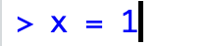
Pane 3: Environment Pane
By default, the Environment pane is located in the top-right and includes the Environment, History, Connections, Build, and Version Control System (VCS) tabs.
The Environment tab displays currently saved R objects. For example, the following code would add ’x’ with value 1 to the environments pane for the duration of the current session.
The environment menu bar provides loading or saving of R Workspaces, interactive import of datasets from text files, Excel, or SPSS/SAS/Stata. It also displays the memory currently used by the active R session, along with a broom icon to remove all current environment objects.
The History tab displays the commands that were executed in the current session, along with search. There are buttons for loading/saving the command history to a file, as well as sending the selected command into the console or inserting it into the current working document. There is a delete button to delete the selected history, or a broom button to remove all history for the current session.
These are the only two relevant tabs for the course. If you are interested in other tabs, see this. An example of the Environment tab from the Environment Pane is shown in the next slide.

Slide 15
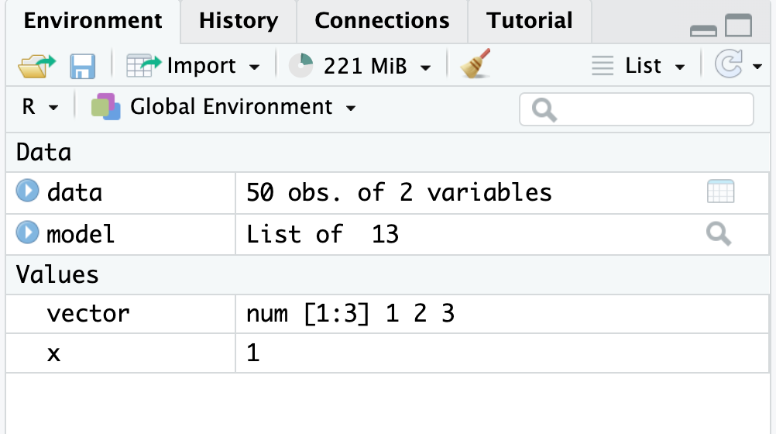
The Environment tab is one of the most useful tabs.
All data and big objects are saved like this, where clicking on the blue circles will display more info about the object
Other vector-related R objects are saved here

Slide 16
Pane 4: Output Pane
By default, the Output pane is the bottom-right pane and displays various outputs such as plots, HTML content, or on-disk files. It contains the Files, Plots, R Packages, Help, Tutorial, Viewer, and Presentation tabs.
Files tab provides an interactive exploration of the current R Project along with the entire directory of the computer. There are menu bar options for adding new folders and new blank files, as well as for deleting or renaming files, as well as a gear pane for additional functions. One of the main uses of the gear pane is to set the working directory. We will go over that later in the slides.
Plots tab will display static images generated by code run in the console or Rscript file until the session is restarted.
Packages tab allows for viewing all installed R packages, and has a search bar for searching the library of packages.
Help tab is used to display package and function documentations. To get help on a specific R function, use the `?functionName` or `help(functionName)` or just type in the function's name in the search bar of the help tab.
Viewer tab is used to display web content such as HTML files, Shiny apps, Quarto-generated web pages, or interactive HTMLwidgets like plotly graphs. All your knitted HW and other files will be displayed here. (More on knitting in later slides)

Slide 17
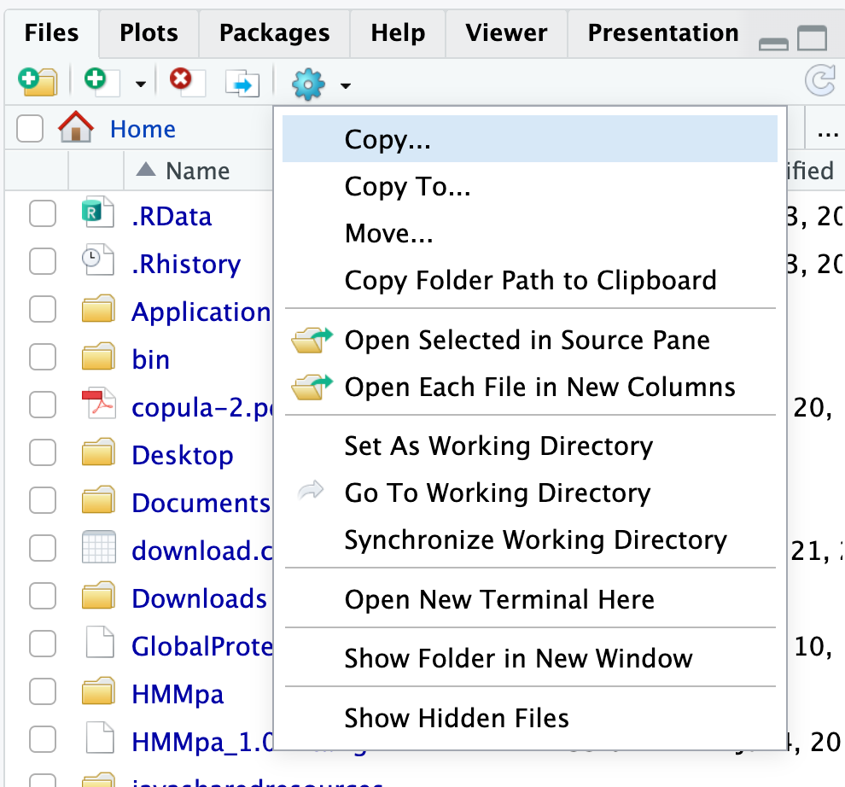
The widget in this course primarily sets the directory. We will go over this later.
Files tab shows all the folders and files on the computer. You can navigate these folder to find your desired files/folders here.

Slide 18
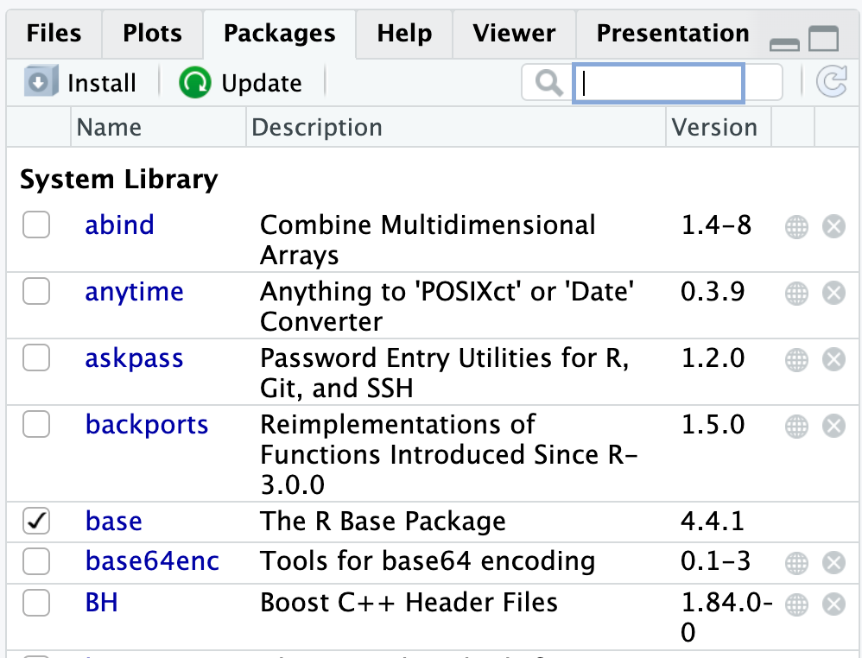
The search panel can be used to search for packages
Loaded packages are selected here to indicate that they are loaded for the current session
The default R package
R primarily comes with some packages which gets installed when your are downloading the software. But you can install new packages by running the code `install.packages(“name of the package”)` or by using the install button here.

Slide 19
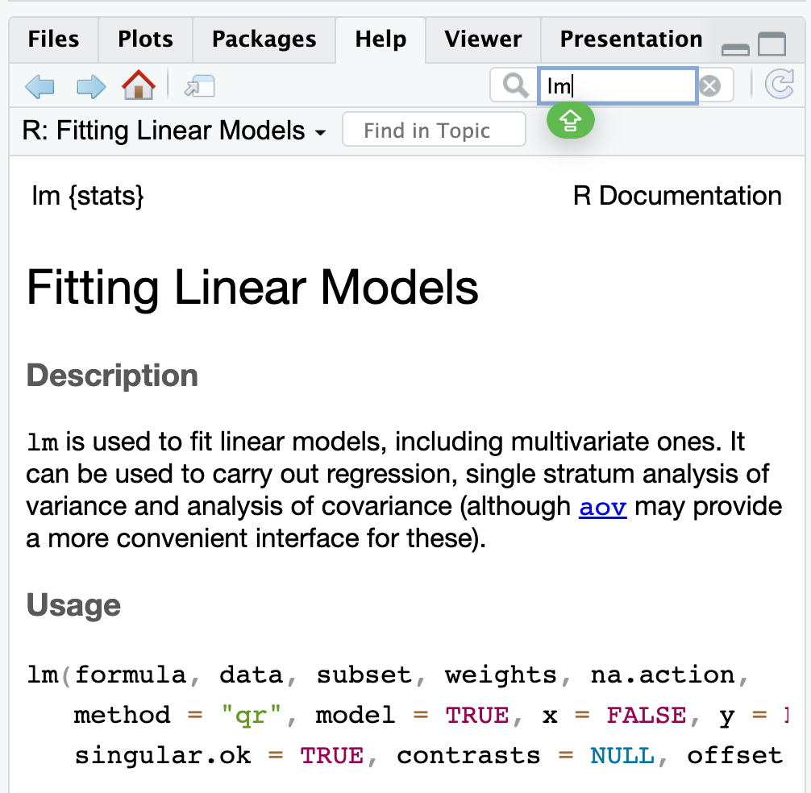
Search bar can be used to search for functions, datasets, etc that come in a packgae
The package where the function is defined
Detailed explanation of the function, including usage, input variables, output variables, examples, etc

Slide 20
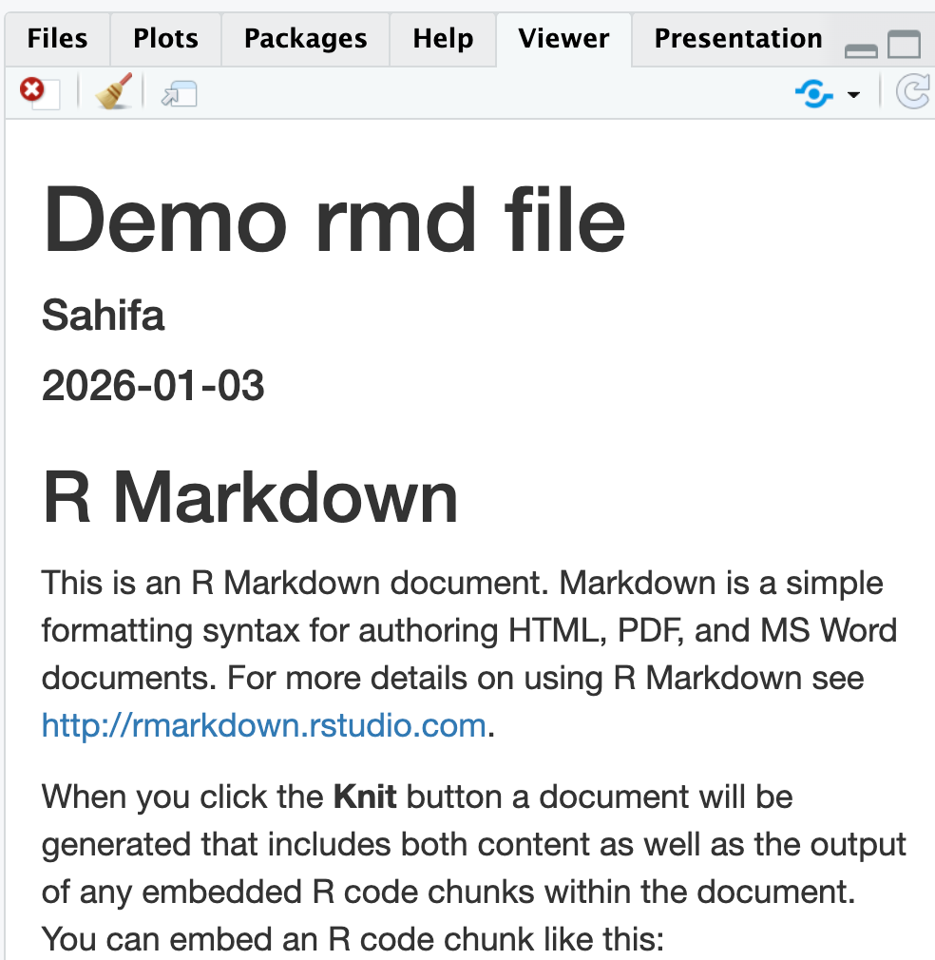
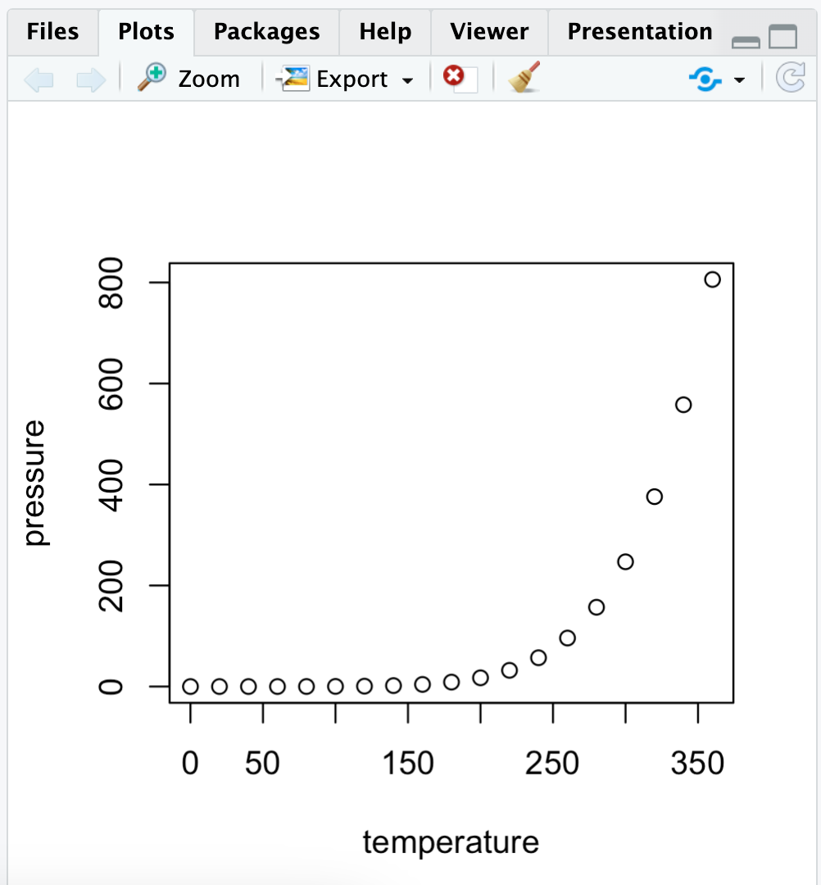
The Viewer tab shows the HTML file obtained from knitting an .Rmd
The Plots tab shows the plots made in the console or R files that don’t have an inline display, such as the .R file.

Slide 21
Pane 1: Source Pane
The source pane allows users to view and edit various code-related files, such as .R, .rmd, .qmd, .py, .css, or general text files such as .txt or .md. By default it is the top-left panel and can be launched by opening any editable file in RStudio. Each additional file that is opened will be added as a new tab within the Source pane.
For this course, we will primarily be working with an R Markdown file. The format of this file is .rmd and can only be opened in R. All your HWs, DIS and lecture notes will be in this format.

Slide 22
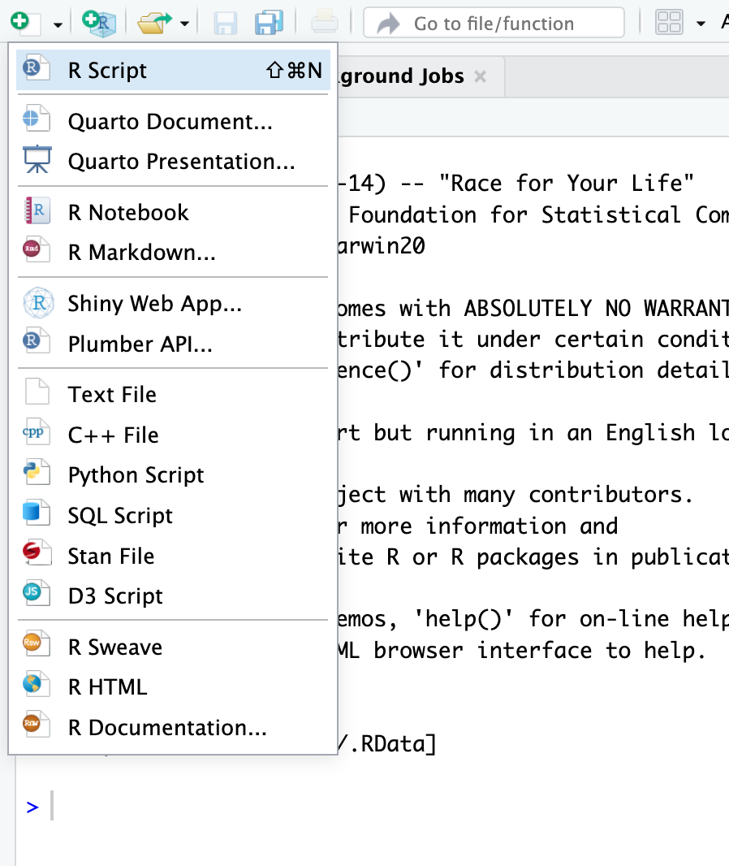

Creating an R format file in Source pane
When you open a new RStudio window, it will not have an open source window, since you haven’t opened or created an R format file.
To create an R format file, such as an R Markdown file, click the green + sign in the top-left corner of your RStudio window.
A drop-down menu will appear, as shown in the image. Choose the option of R Markdown to open a new R Markdown file.
You can also create other R format files such as the R Script or Text File, to name a few.

Slide 23
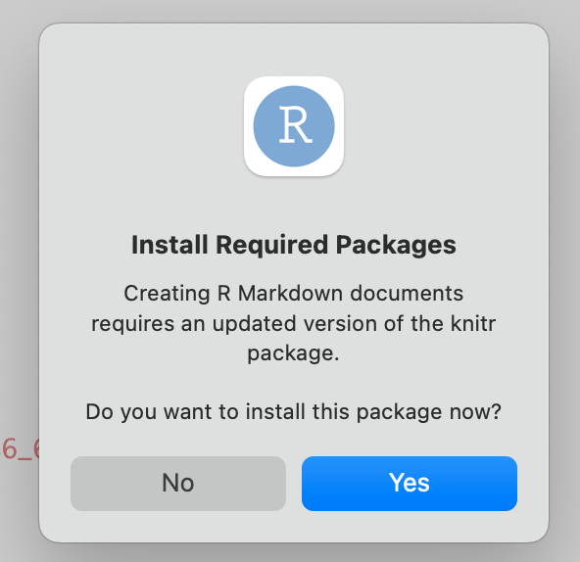
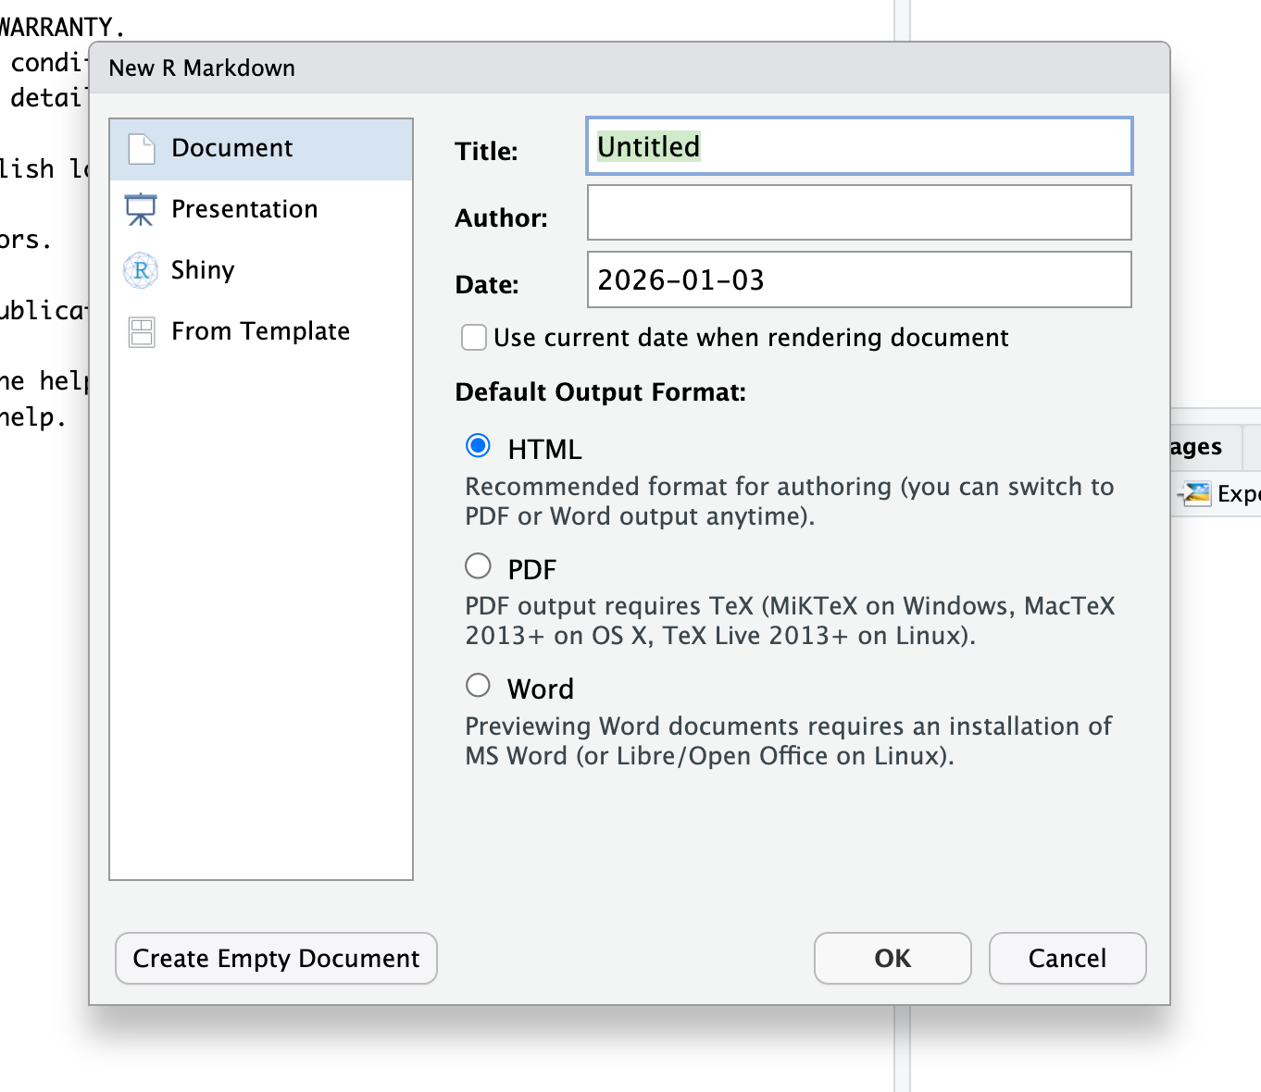
Once you select the R Markdown option, a prompt similar to the one shown in the image below will open. For first-time users, it will prompt you to download the necessary packages to create an R Markdown file. Just click Yes, and it will automatically start downloading the required packages. Once done, you will see the window as shown in the image below.
Here you can select the title, author, date, and format of the output document.
Once you click OK, a new .rmd file will be created.
In this course, we primarily want the output in HTML format. But you can also generate output files as a pdf or word. You might need additional packages to do so.

Slide 24
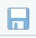
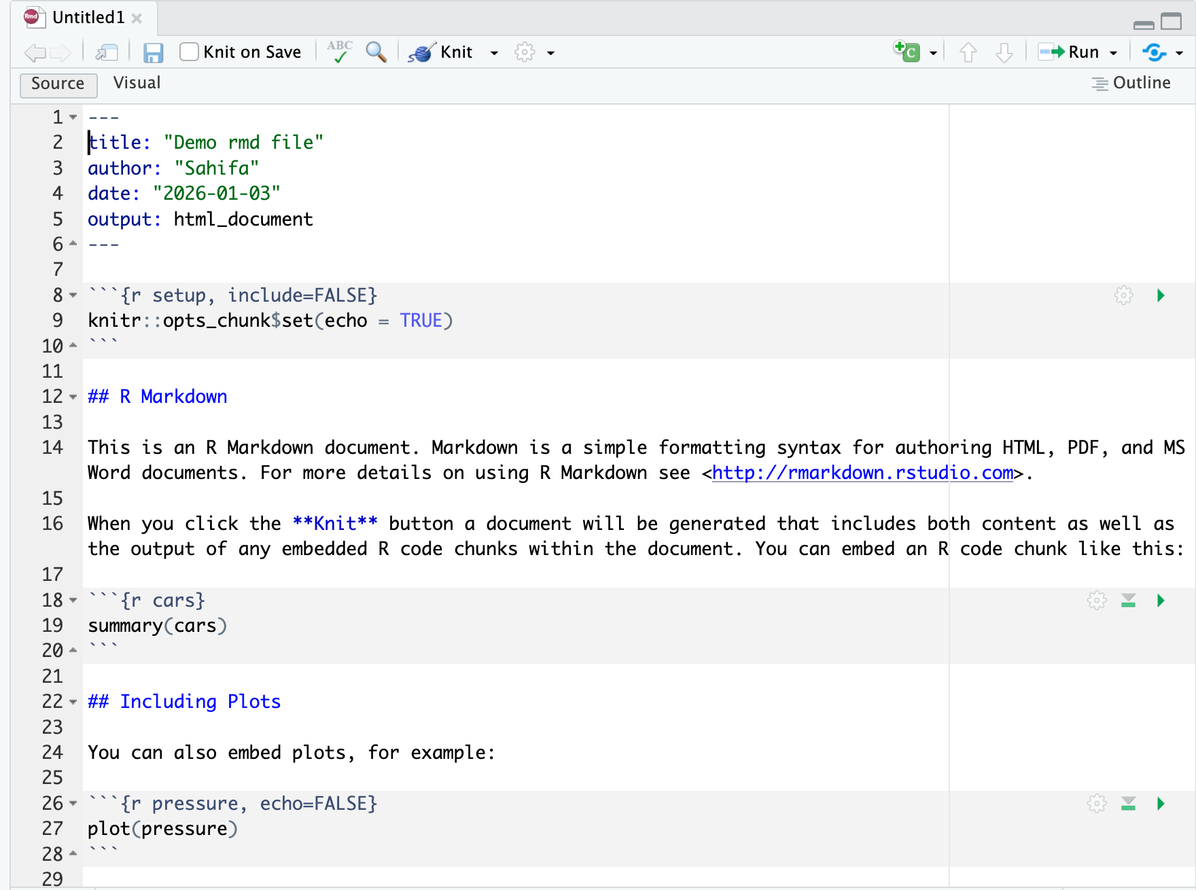
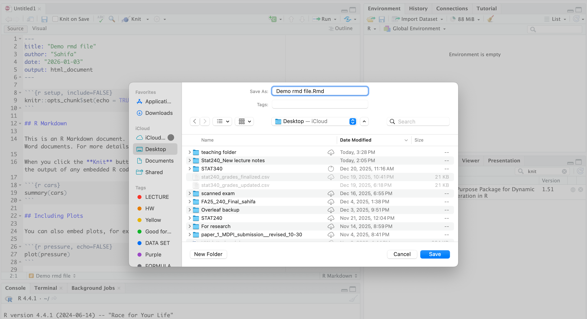
A new R Markdown file looks like the image below. You can see in the image below that the file’s name in the top tab is “Untitled1”. This is because the file has not been saved yet. To save the file, click on the icon and select the location where you want to save it on your computer. Once saved, the file name will be displayed accordingly.
For the course, it’s suggested that you save .Rmd files in the folders related to what you are working with. For example, if you are working on your HW1, save the .Rmd file in the HW -> HW1 folder of your STAT240 folder.

Slide 25
Let’s understand the different parts of an .Rmd file
YAML
Global R chunk
Body
R chunk

Slide 26
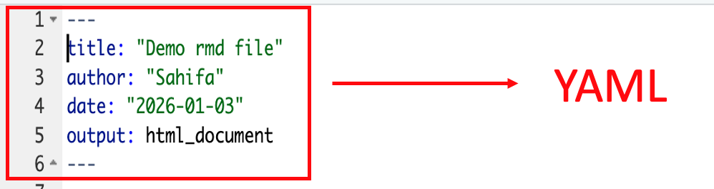
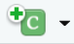
YAML: This is usually present in the beginning of an R Markdown file and contains the command for the output file. Such as the title of the document, authorship, date and format. It is defined in between pairs of three dashes ‘-’. This part is mandatory for every R Markdown file.
R chunk
R chunk: This is where all the R code goes in an R Markdown. Any R code outside of this gray box is not considered code by the R Markdown file and will not run or appear in the output file. It is defined with three backticks (`) and {r}, and ends with three backticks (`). R chunks can be executed/run by clicking the green triangle on the right or by using ‘Ctrl + Enter’ for Windows and ‘command + Enter’ for MAC.
A new R chunk can be inserted using the shortcut ‘Ctrl + Alt + I’ for Windows and ‘command + option + I’ for MAC or by clicking the on the top right of the documents tab and selecting R from the drop-down menu.
Any commentary needed in the R chunk can be added by inserting # in front of the text.

Slide 27
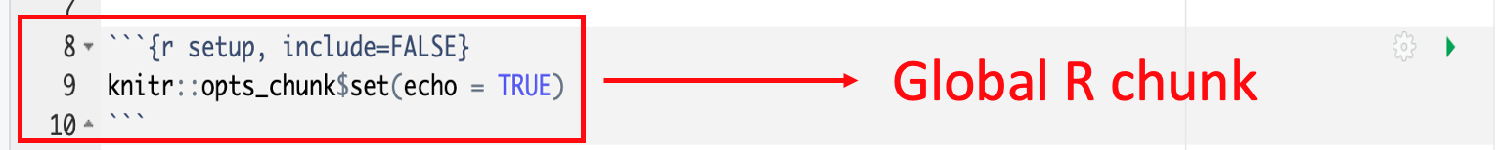
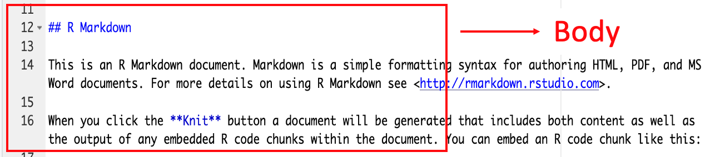
Global R chunk: This is where a general rule for all R chunk is provided for the output file. For example, ’echo = TRUE’ makes all the R chunks appear in the output unless set otherwise, ‘error = TRUE’ overrides the R Markdown file's default setting to stop at the first error, and also makes the R chunks with errors appear in the output, and so on. Every R chunk in the output file will follow this chunk unless specified otherwise for any individual chunk.
Body: Any text entered anywhere else on the R Markdown file serves as the body of the output document. Headings are created with hashtags (#), with more hashtags creating subheadings. These also automatically create sections and subsections in the document’s layout. Regular text creates the body of the paragraph. Bold text can be created using two asterisks (*) on both sides of the text, whereas italic text needs one asterisk (*) on both sides of the text. Bullet points can be created by putting a dash (-) or numbering in front of the text. Text encased in backticks appear in a gray box in the output. External links can be inserted as [text](hyperlink). An example is shown on the next slide.

Slide 28
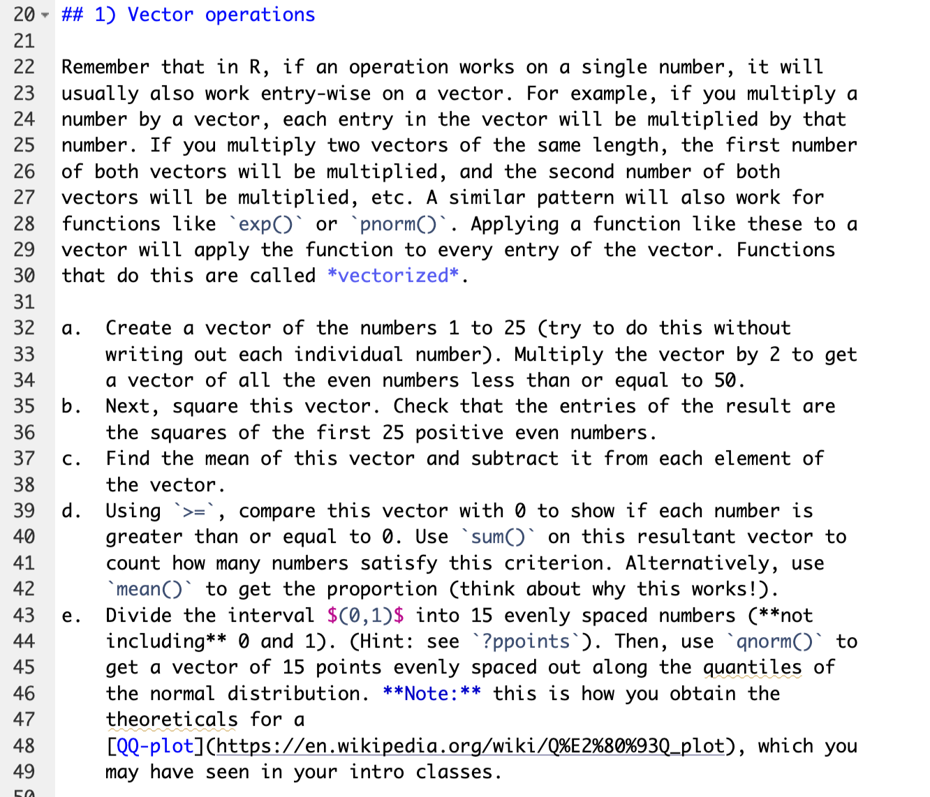
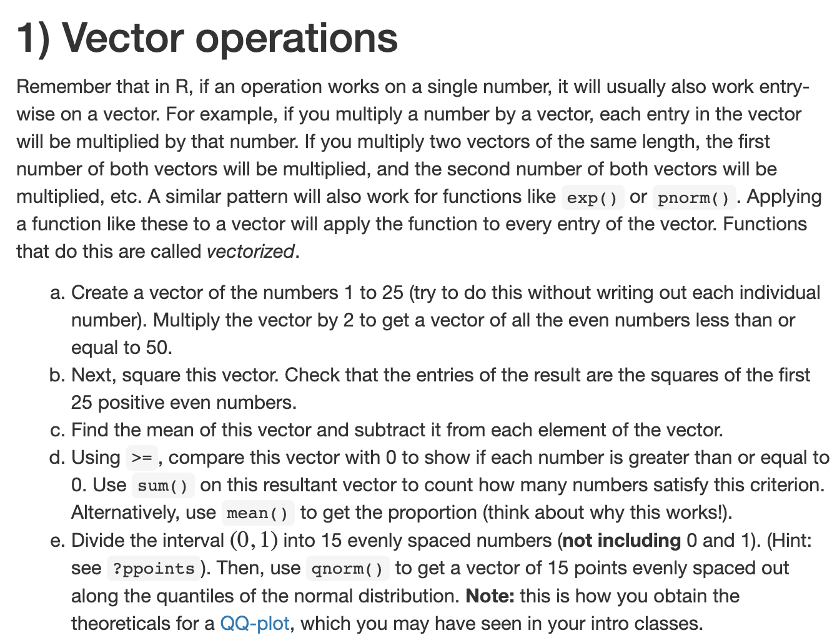
Source .Rmd file
Output

Slide 29
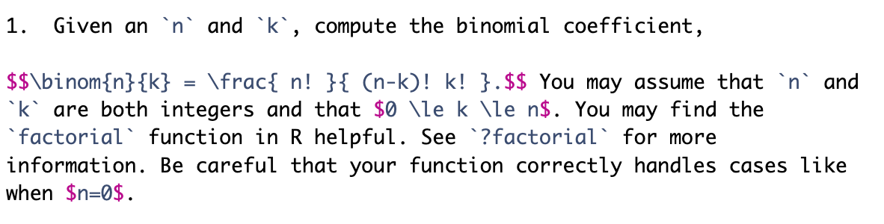
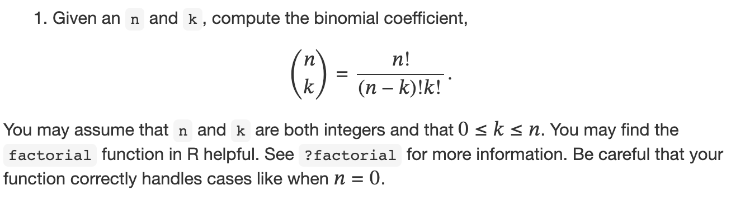
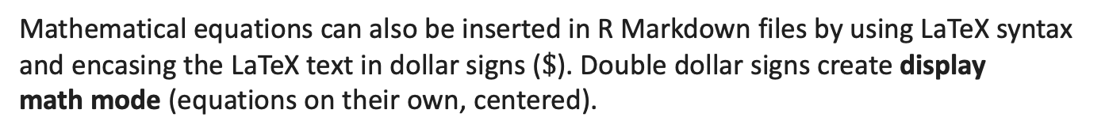
Mathematical equations can also be inserted in R Markdown files by using LaTeX syntax and encasing the LaTeX text in dollar signs ($\$$). Double dollar signs create display math mode (equations on their own, centered).
Source .Rmd file:
Output

Slide 30

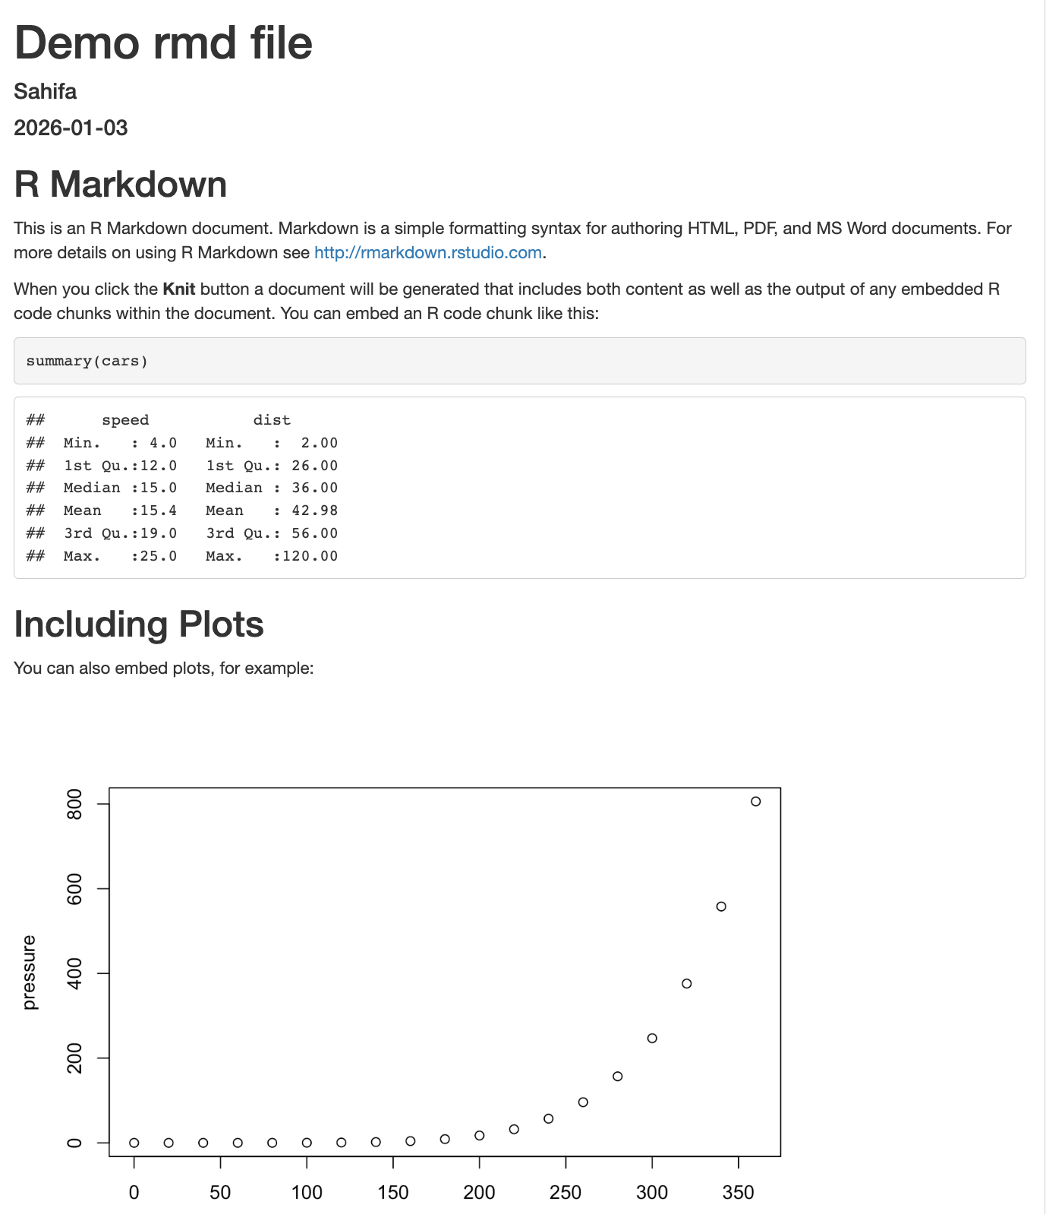
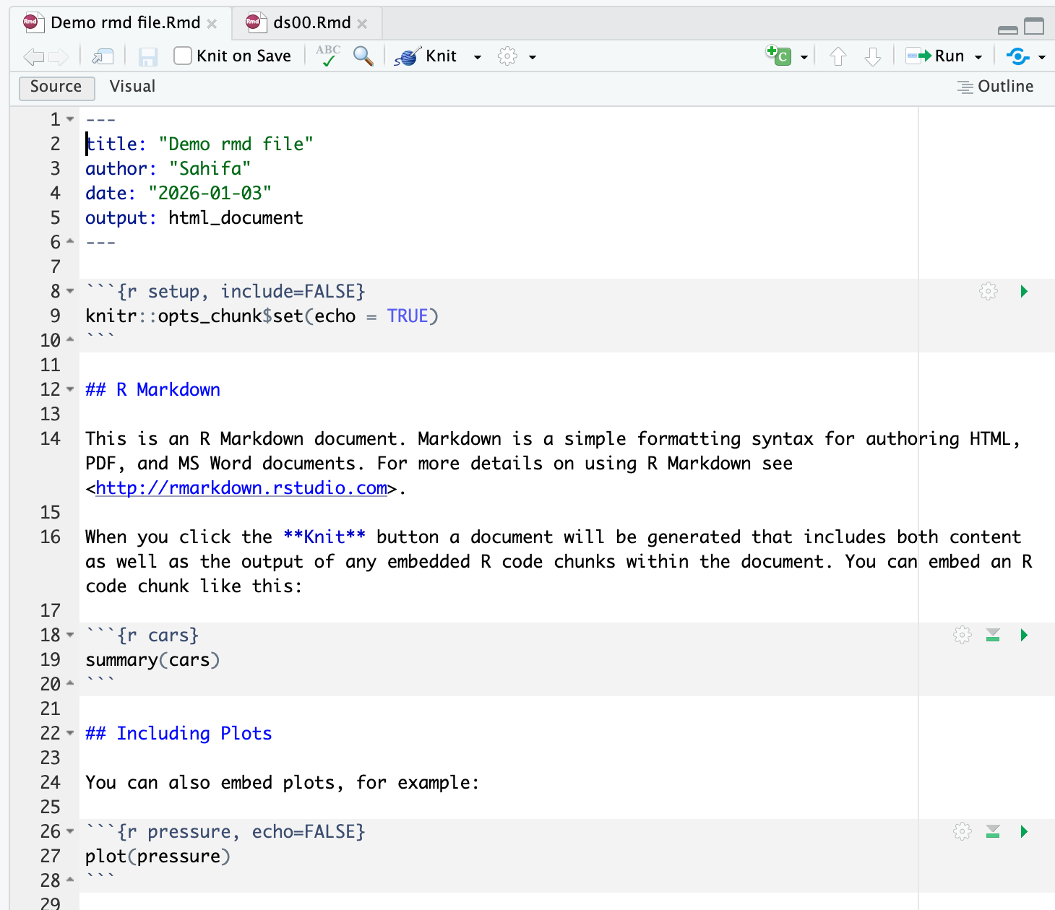
How is the output file created?
Up until now, we have only seen how to manage or organize an R Markdown file. But how is the output file created? What does it look like?
To create the output file, mostly the html file, we need to `knit` the R Markdown file. This can be done by clicking on the icon in the top center of the document tab on the source pane. The output html file generated will be saved in the same folder as the original .Rmd file.

Slide 31
Why an R Markdown file?
RStudio provides other file formats such as the R script (.R file) but it can only save the code. R scripts are ideal for writing and executing code for analysis. Any text inserted has to begin with hashtags and cannot be anything other than regular text.
R Markdown is preferred over other R format files due to its ability to create a single, dynamic document that combines code, commentary, and results into a high-quality report.
Its outputs are often compatible with regular computer software, making it easier to view the documents. Since it also includes the output of the codes, it makes it easier to share your work with others.
Useful Link: https://bookdown.org/yihui/rmarkdown/rmdformats.html

Slide 32
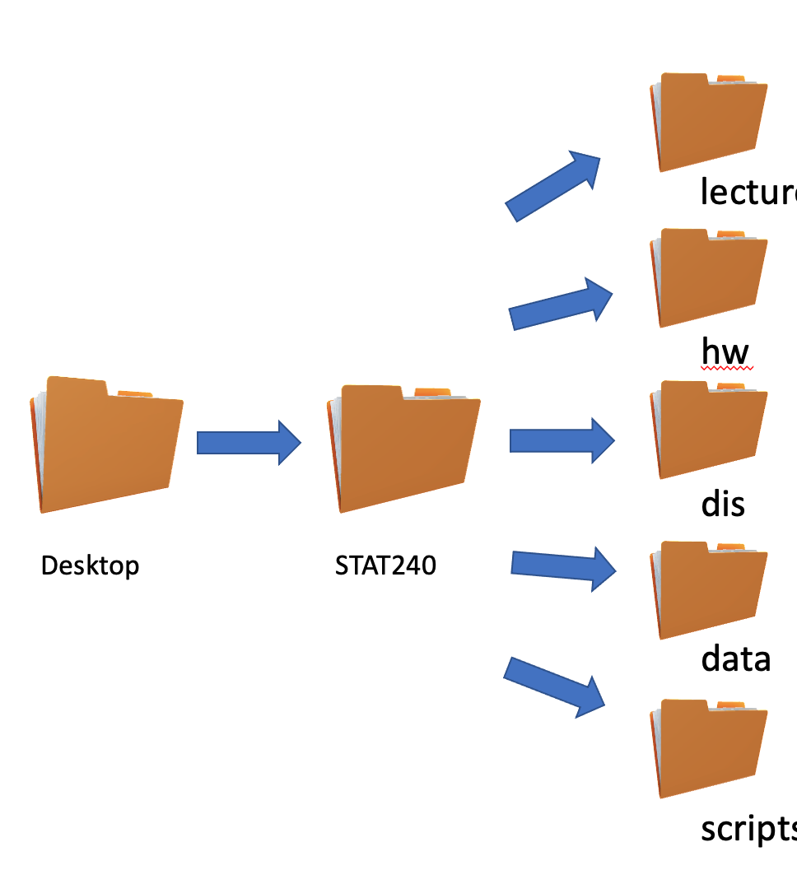
Setting the Directory for STAT 240 in your devices
Your HWs and DIS will use these paths that will help automatically load datasets and save your files.
You can do it manually, but it’s a little complicated. You can write your own paths, which I will show you how to do later, but I don’t recommend it until and unless you know what you are doing.
lecture
All of you should set up your directories to look like this:
scripts

Slide 33
All of your lecture RMD files, HWs, and DIS will already have the path to the directories written for you. You don’t need to change it if you set your directories the way shown in the previous slides.
If needed, you can manually write the path to directories:
Mac Users: “~/Desktop/STAT 240/name of the folder that you want to go to/name of the next folder/…/name of the file”
Window Users: “C:User/Desktop/STAT 240/name of the folder that you want to go to/name of the next folder/…/name of the file”

Slide 34
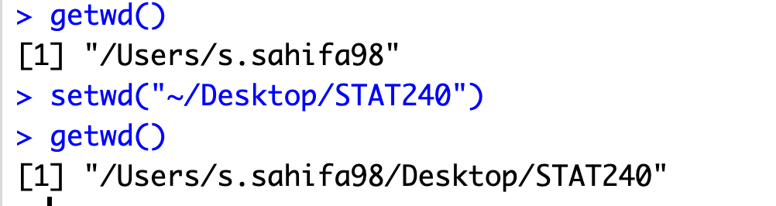
Setting working directory in RStudio
Setting the working directory in R is crucial because it establishes a base location for all file input and output operations, ensuring that the script can reliably find source files and save output in a predictable place. There are several ways to do this. Two of the main ways you can use for this course:
Using the console (the most effective method):
You can use the code setwd(“path to the folder”) to set a certain folder as the working directory. You can get an idea what your working directory is by using `getwd()` in the console. For example, I will set the STAT240 folder as my working directory:

Slide 35
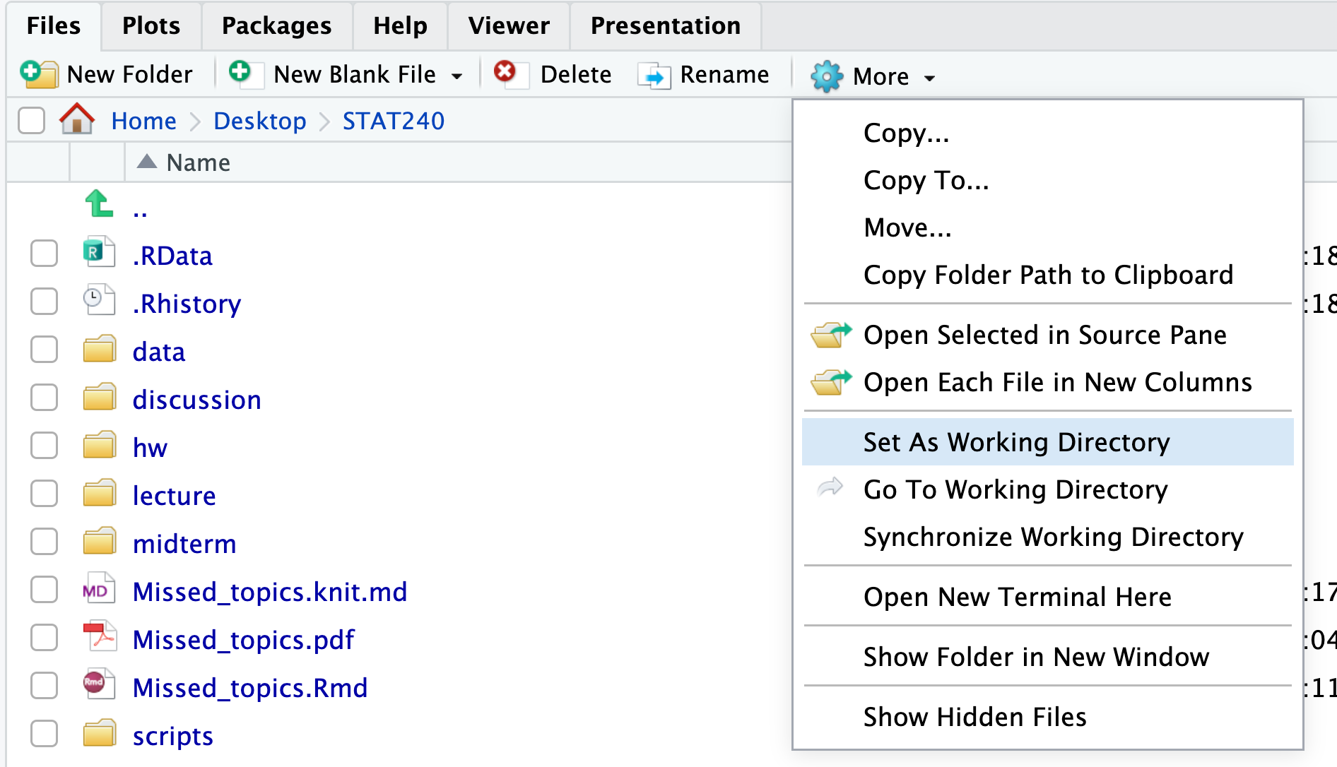
Using the Files tab (the shortcut):
You can navigate to the desired folder in the Files tab, then use the widget's drop-down menu to set it as the working directory by clicking “Set As Working Directory”. You can check where the working directory is by clicking “Go To Working Directory”.
This method poses problems for some Windows user as it’s difficult to locate the Desktop in the Files tab, you can use method in the previous slide or come meet me.

Slide 36
We end these lecture slides here. The lecture notes will be continued which will cover the basic syntax of R and different types of objects in R.

